Slide 1
Odoo - version update Proposal

Slide 2
Context and Background
Odoo ERP is one of the crucial part of the KOKO Software products. It is used extensively to manage the Sales, Purchase, Warehousing and Finance operations of company. In KOKO, Finance and Operations are fully dependent on the ERP.
KOKO started implementing the ERP in the year 2018 when Odoo Version 11 was in market. Now in December 2020, version 14 is in the market. As per the policy Odoo Version 11 would be soon out of support we do plan for the version upgrade of Odoo.

Slide 3
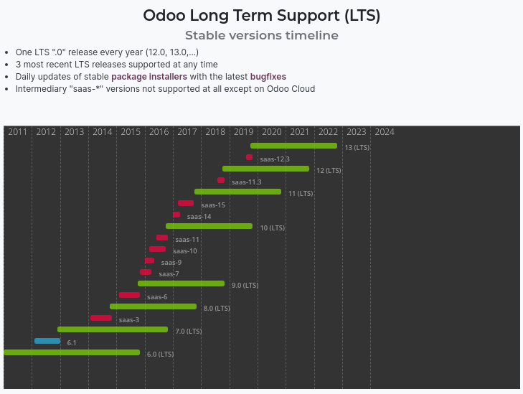
Odoo Support Architecture
As per Odoo policy, Odoo provides support only for the 3 stable version in the market at a time. As the version 14 is in Market, odoo support will be for Version 12,13 and 14.
For more information Click Here

Slide 4
Which Version to upgrade
Odoo Version 14 is the latest version of the Odoo and we must be upgrading to this version only for the following reasons:
It provides the longest term of support going forward.
Updated Technical stack with faster processing speed.
Improved and better User Experience.
Fully Mobile responsive, allowing user to access the system anywhere.
For a Odoo 14 Release Notes, click here
Checkout Odoo Version 14 here

Slide 5
Version Upgrade Process

Slide 6
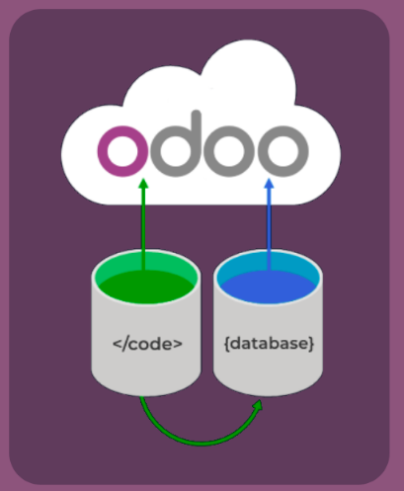
Upgradation Steps and Opportunities
To migrate the to the new Version we have following points to take in our consideration:
Code Migration to the newer version - Odoo Module
Code Migration to newer Version - Customised Module
Data Migration
Optimisation of the existing codes and Processes in the system
Writing reusable Migration scripts [To be used in the Migration whenever required.]
Code Filtration [Remove the nonrequired code]
Overcome Architectural changes.
Test case Enhancement [As many functionalities got implemented and changed but we don’t have the test cases updated.]

Slide 7

Use Odoo Scripts for Version Upgrade
Use Following command , on the machine where your database is hosted
python <(curl -s upgrade.odoo.com/upgrade) test -d <your db name> -t <target version> -c <your subscription code>
The above command will dump your database to a file, then send it to the upgrade platform for upgrade, displaying you the live logs, then restore the upgraded database back to your server, to a duplicate, test, database.

Slide 8
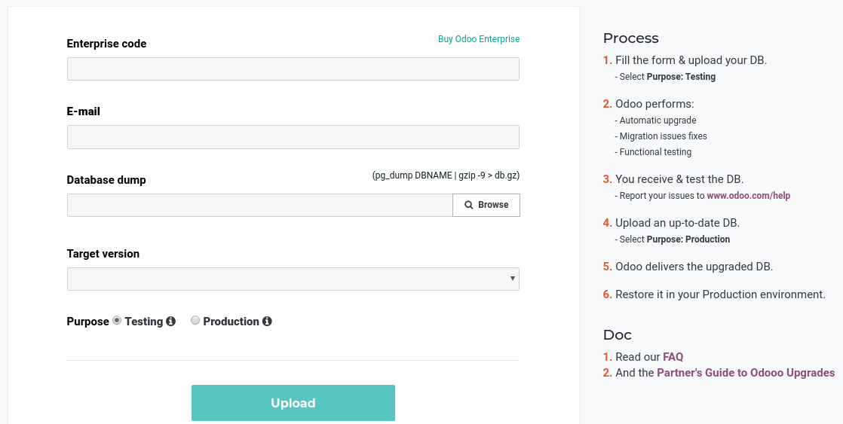
Use Odoo Scripts for Version Upgrade
In case the Above process does not work we can use the link here to upgrade to the newer version. This link will take us to the following form where we can upload the database dump and upgrade to newer version.

Slide 9
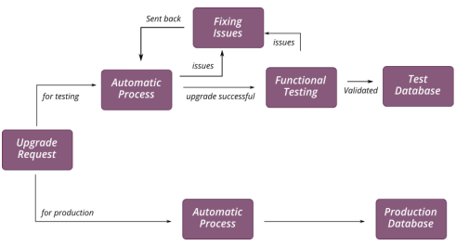
Use Odoo Scripts for Version Upgrade
Odoo upgrade process can be summarized as:

Slide 10
Use Odoo Scripts for Version Upgrade
For more technical inputs on the Odoo version upgrade, refer the following Partner’s Guide to Odoo Upgrades.
Reference :
https://legacy-upgrade.odoo.com/upgrade/static/partner-s-guide-to-odoo-upgrades.pdf
https://www.odoo.com/documentation/14.0/webservices/upgrade.html

Slide 11
Use Odoo Scripts for Version Upgrade
What happens in the database upgrade process:
When we upload our database the Database dump is shared with the Odoo Belgium team.
The team runs the Automated scripts on the database to migrate in to the newer version.
If we have the custom modules involved, team will write the scripts to map the data and and the same will be used while migrating that for production database.
This Process of database migration can take from 1 to 3 months.
Custom Code upgrade to the Odoo version 14:
We can either go to odoo to get our code updated to the newer version of Odoo or we can do this with in KOKO.
Preferred method would be to go with the inhouse upgrade model, in order to catalog all the changes we want to make in the system.

Slide 12
Action Plan

Slide 13
Action For the Version Upgrade
As described before we talked about two major parts for the Odoo version upgrade process which were the database upgrade and the code upgrade.
The database upgrade is a straightforward process which will be done by Odoo Belgium Itself.
For the Code Migration to the newer version we need to run some analysis on the new version to go through the new Python Library Introduced, Changes in the database tables and other architectural details.
Code Analysis [ and some POC ] can be done in 6 to 8 Days and this would be enough to provide the estimated time for code migration to the new version.
Resource Requirements:
This process will require one experience Odoo resource [dedicated for 8 days].

Slide 14
Thank You !!

